Slide 1
Using SQL Developer

Slide 2
Objectives
After completing this appendix, you should be able to do the following:
  List the key features of Oracle SQL Developer
  Install Oracle SQL Developer
  Identify menu items of Oracle SQL Developer
  Create a database connection
  Manage database objects
  Use the SQL Worksheet
  Execute SQL statements and SQL scripts
  Edit and Debug PL/SQL statements
  Create and save reports
Notes:
Oracle Database 10g: PL/SQL Fundamentals E-<number>
Objectives
This appendix introduces the graphical tool SQL Developer that simplifies your database development tasks. You learn how to use SQL Worksheet to execute SQL statements and SQL scripts. You also learn how to edit and debug PL/SQL.

Slide 3

What Is Oracle SQL Developer?
  Oracle SQL Developer is a graphical tool that enhances productivity and simplifies database development tasks.
  You can connect to any target Oracle database schema using standard Oracle database authentication.
SQL Developer
Notes:
Oracle Database 10g: PL/SQL Fundamentals E-<number>
What Is Oracle SQL Developer?
Oracle SQL Developer is a free graphical tool designed to improve your productivity and simplify the development of every-day database tasks. With just a few clicks, you can easily create and debug stored procedures, test SQL statements, and view optimizer plans.
SQL Developer, the visual tool for database development, simplifies the following tasks:
Browsing and managing database objects
Executing SQL statements and scripts
Editing and debugging PL/SQL statements
Creating reports
You can connect to any target Oracle database schema using standard Oracle database authentication. Once connected, you can perform operations on objects in the database.

Slide 4
Key Features
  Developed in Java
  Supports Windows,Linux and Mac OS X platforms
  Default connectivity by using the JDBC Thin driver
  Does not require an installer
  Connects to any Oracle Database version 9.2.0.1 and later
  Bundled with JRE 1.5
Notes:
Key Features of SQL Developer
Oracle SQL Developer is developed in Java leveraging the Oracle JDeveloper IDE. The tool runs on Windows, Linux, and Mac OS X platforms. You can install SQL Developer on the Database Server and connect remotely from your desktop, thus avoiding client server network traffic.
Default connectivity to the database is through the JDBC Thin driver so, no Oracle Home is required. SQL Developer does not require an installer and you need to simply unzip the downloaded file.
With SQL Developer, users can connect to Oracle Databases 9.2.0.1 and later, and all Oracle database editions including Express Edition. SQL Developer is bundled with JRE 1.5, with an additional tools.jar to support Windows clients. Non-Windows clients only need JDK 1.5.

Slide 5
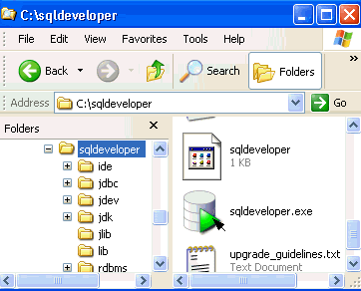
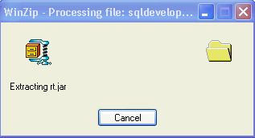
Installing SQL Developer
Download Oracle SQL Developer kit and unzip into any directory on your machine
Notes:
Installing SQL Developer
Oracle SQL Developer does not require an installer. To install SQL Developer, you need an unzip tool.
To install SQL Developer, perform the following steps:
1. Create a folder as <local drive>:\SQL Developer.
2. Download the SQL Developer kit from
http://www.oracle.com/technology/software/products/sql/index.html
3. Unzip the downloaded SQL Developer kit into the folder created in step 1.
To start SQL Developer, go to <local drive>:\SQL Developer, and double-click sqldeveloper.exe.

Slide 6
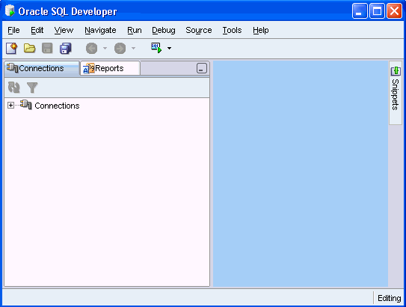
Menus for SQL Developer
2
4
6
1
3
5
Notes:
Menus for SQL Developer
SQL Developer has two main navigation tabs.
Connections Navigator: By using this tab, you can browse database objects and users to which you have access.
Reporting Tab: By using this tab, you can run predefined reports or create and add your own reports.
SQL Developer uses the left side for navigation to find and select objects, and the right side to display information about selected objects. You can customize many aspects of the appearance and behavior of SQL Developer by setting preferences.
The menus at the top contain standard entries, plus entries for features specific to SQL Developer.
1. View: Contains options that affect what is displayed in the SQL Developer interface
2. Navigate: Contains options for navigating to panes and in the execution of sub programs
3. Run: Contains the Run File and Execution Profile options, which are relevant when a function or procedure is selected
4. Debug: Contains options relevant when a function or procedure is selected
5. Source: Contains options for use when editing functions and procedures
6. Tools: Invokes SQL Developer tools such as SQL*Plus, Preferences, and SQL Worksheet

Slide 7
Creating a Database Connection
  You must have at least one database connection to use SQL Developer
  You can create and test connections
    For multiple databases
    For multiple schemas
  SQL Developer automatically imports any connections defined in the tnsnames.ora file on your system.
  You can export connections to an XML file
  Each additional database connection created is listed in the connections navigator hierarchy
Notes:
Creating a Database Connection
A connection is a SQL Developer object that specifies the necessary information for connecting to a specific database as a specific user of that database. To use SQL Developer, you must have at least one database connection, which may be existing, created, or imported.
You can create and test connections for multiple databases and for multiple schemas.
By default, the tnsnames.ora file is located in the $ORACLE_HOME/network/admin directory. But, it can also be in the directory specified by the TNS_ADMIN environment variable or registry value. When you start SQL Developer and display the database connections dialog box, SQL Developer automatically imports any connections defined in the tnsnames.ora file on your system.
Note: On Windows systems, if the tnsnames.ora file exists but its connections are not being used by SQL Developer, define TNS_ADMIN as a system environment variable.
You can export connections to an XML file so that you can reuse later.
You can create additional connections as different users to the same database or to connect to the different databases.

Slide 8
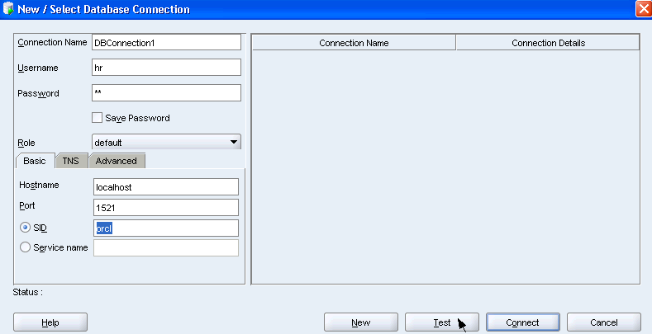
Creating a Database Connection
Notes:
Creating a Database Connection (continued)
To create a database connection, perform the following steps:
1. Double-click <your_path>\sqldeveloper\sqldeveloper.exe.
2. In the Connections tab, right-click Connections and select New Database Connection.
3. Enter the connection name, username, password, hostname, and SID for the database you want to connect.
4. Click Test to make sure that the connection has been set correctly.
5. Click Connect.
In the basic tabbed page, at the bottom, fill in the following options:
Hostname: the Host system for the Oracle database
Port: Listener port
SID: Database name
Service Name: Network service name for a remote database connection
If you select the Save Password check box, the password is saved to an XML file. So, once you close SQL Developer connection and open again, you will not be prompted for the password.

Slide 9
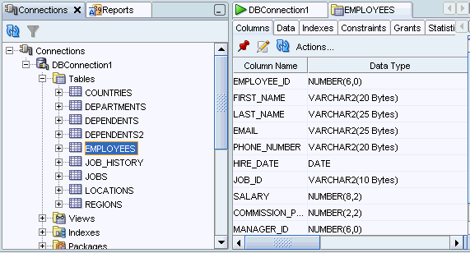
Browsing Database Objects
Use the Database Navigator to:
  Browse through many objects in a database schema
  Review the definitions of objects at a glance
Notes:
Browsing Database Objects
Once you have created a database connection, you can use the Database Navigator to browse through many objects in a database schema including Tables, Views, Indexes, Packages, Procedures, Triggers, Types, and so on.
SQL Developer uses the left side for navigation to find and select objects, and the right side to display information about the selected objects. You can customize many aspects of the appearance of SQL Developer by setting preferences.
You can see the definition of the objects broken into tabs of information that is pulled out of the data dictionary. For example, if you select a table in the Navigator, the details about columns, constraints, grants, statistics, triggers and more are all displayed in an easy to read tabbed window.
If you want to see the definition of EMPLOYEES table as shown on the slide, perform the following steps:
1. Expand the connection node in the Connections Navigator
2. Expand Tables.
3. Double-click EMPLOYEES.
Using the Data tab, you can enter new rows, update data and commit these changes to the database.

Slide 10
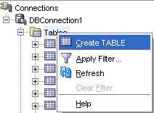
Creating a Schema Object
  SQL Developer supports the creation of any schema object by:
    Executing a SQL statement in the SQL Worksheet
    Using the context menu
  Edit the objects using an edit dialog or one of many context sensitive menus
  View the DDL for adjustments such as creating a new object or editing an existing schema object
Notes:
Creating a Schema Object
SQL Developer supports the creation of any schema object by executing a SQL statement in the SQL Worksheet. Alternatively, you can create objects using the context menus. Once created, you can edit the objects using an edit dialog or one of many context sensitive menus.
As new objects are created or existing objects are edited, the DDL for those adjustments is available for review. An Export DDL option is available if you want to create the full DDL for one or more objects in the schema.
The slide shows creating a table using the context menu. To open a dialog box for creating a new table, right-click Tables and select Create TABLE. The dialog boxes for creating and editing database objects have multiple tabs, each reflecting a logical grouping of properties for that type of object.

Slide 11
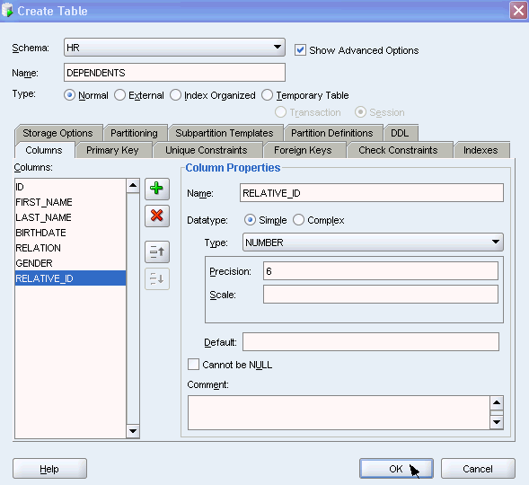
Creating a New Table: Example
Notes:
Creating a New Table: Example
In the Create Table dialog box, if you do not select the Show Advanced Options check box, you can create a table quickly by specifying columns and some frequently used features.
If you select the Show Advanced Options check box, the Create Table dialog box changes to one with multiple tabs, in which you can specify an extended set of features while creating the table.
The example in the slide shows creating the DEPENDENTS table by selecting the Show Advanced Options check box.
To create a new table, perform the following steps:
1. In the Connections Navigator, right-click Tables.
2. Select Create TABLE.
3. In the Create Table dialog box, select Show Advanced Options.
4. Specify column information.
5. Click OK.
Although it is not required, you should also specify a primary key using the Primary Key tab in the dialog box. Sometimes, you may want to edit the table that you have created. To edit a table, right-click the table in the connections navigator, and select Edit.

Slide 12
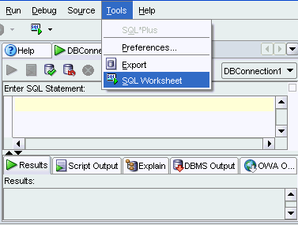
Using the SQL Worksheet
  Use the SQL Worksheet to enter and execute SQL, PL/SQL, and SQL *Plus statements
  Specify any actions that can be processed by the database connection associated with the worksheet
Notes:
Using the SQL Worksheet
When you connect to a database, a SQL Worksheet window for that connection is automatically opened. You can use the SQL Worksheet to enter and execute SQL, PL/SQL, and SQL*Plus statements. The SQL Worksheet supports SQL*Plus statements to a certain extent. SQL*Plus statements that are not supported by the SQL Worksheet are ignored and not passed to the database.
You can specify any actions that can be processed by the database connection associated with the worksheet, such as:
Creating a table
Inserting data
Creating and editing a trigger
Selecting data from a table
Saving the selected data to a file
You can display a SQL Worksheet by using any of the following two options:
Select Tools > SQL Worksheet
Click the Open SQL Worksheet icon.

Slide 13
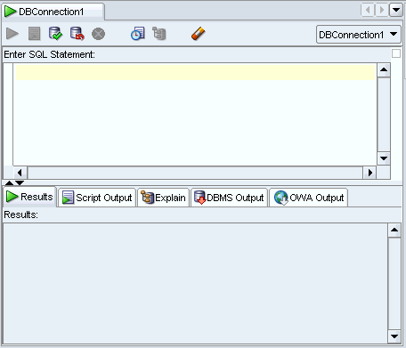
Using the SQL Worksheet
2
4
6
1
8
5
7
3
Notes:
Using the SQL Worksheet (continued)
You may want to use short cut keys or icons to perform certain tasks such as executing a SQL statement, running a script, and viewing the history of SQL statements that you have executed. You can use the SQL Worksheet toolbar that contains icons to perform the following tasks:
1. Execute Statement: Executes the statement at the mouse pointer in the Enter SQL Statement box. You can use bind variables in the SQL statements but not substitution variables.
2. Run Script: Executes all statements in the Enter SQL Statement box using the Script Runner. You can use substitution variables in the SQL statements but not bind variables.
3. Commit: Writes any changes to the database, and ends the transaction.
4. Rollback: Discards any changes to the database, without writing them to the database, and ends the transaction.
5. Cancel: Stops the execution of any statements currently being executed.
6. SQL History: Displays a dialog box with information about SQL statements that you have executed.
7. Execute Explain Plan: Generates the execution plan, which you can see by clicking the Explain tab.
8. Clear: Erases the statement or statements in the Enter SQL Statement box.

Slide 14
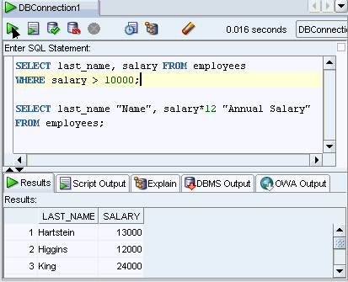
Executing SQL Statements
Use the Enter SQL Statement box to enter single or multiple SQL statements
Notes:
Executing SQL Statements
In the SQL Worksheet, you can use the Enter SQL Statement box to type a single or multiple SQL statements. For a single statement, the semicolon at the end is optional.
When you type in the statement, the SQL keywords are automatically highlighted. To execute a SQL statement, ensure that your cursor is within the statement and click the Execute Statement icon. Alternatively, you can press the F9 key.
To execute multiple SQL statements and see the results, click the Run Script icon. Alternatively, you can press the F5 key.
In the example in the slide, as there are multiple SQL statements, the first statement is terminated with a semicolon. The cursor is in the first statement and so when the statement is executed, results corresponding to the first statement are displayed in the Results box.

Slide 15
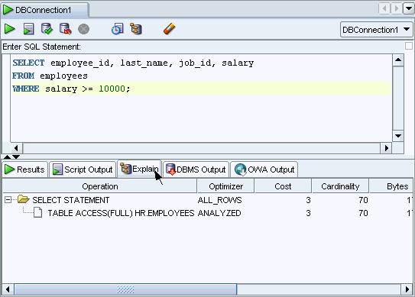
Viewing the Execution Plan
Notes:
Viewing the Execution Plan
You can execute a SQL script, and view the execution plan. To execute a SQL script file, perform the following steps:
1. Right-click in the Enter SQL Statement box, and select Open File from the drop down menu.
2. In the Open dialog box, double-click the .sql file.
3. Click the Run Script icon.
Once you double-click the .sql file, the sql statements are loaded into the Enter SQL Statement box. You can execute the script or each line individually. The results are displayed in the Script Output area.
The example in the slide shows the execution plan. The Execute Explain Plan icon generates the execution plan. An execution plan is the sequence of operations that will be performed to execute the statement. You can see the execution plan by clicking the Explain tab.

Slide 16
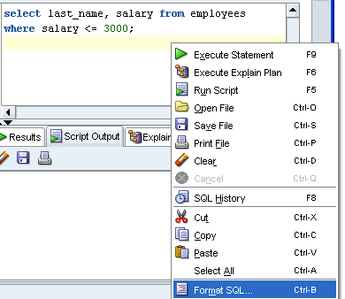

Formatting SQL Code
Before
formatting
After
formatting
Notes:
Formatting SQL Code
You may want to enhance the indentation, spacing, capitalization, and line separation of SQL code. SQL Developer enables you to format SQL code.
To format SQL code, right-click in the statement area, and select Format SQL.
In the example in the slide, before formatting, the SQL code has the key words not capitalized and the statement is not properly indented. After formatting, the SQL code is enhanced with the keywords capitalized and the statement properly indented.

Slide 17
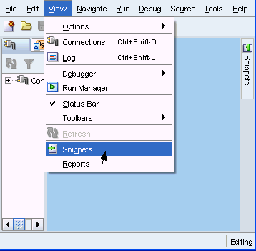
Using Snippets
Snippets are code fragments that may be just syntax or examples
Notes:
Using Snippets
You may want to use certain code fragments when you are using the SQL Worksheet or creating or editing a PL/SQL function or procedure. SQL Developer has the Snippets feature. Snippets are code fragments, such as SQL functions, Optimizer hints, and miscellaneous PL/SQL programming techniques. You can drag and drop snippets into the editor window.
To display Snippets, select View > Snippets.
The snippets window is displayed on the right side. You can use the drop down list to select a group. A snippets button is placed in the right window margin, so that you can display the snippets window if it becomes hidden.

Slide 18
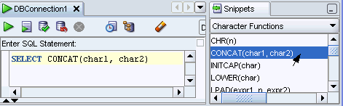
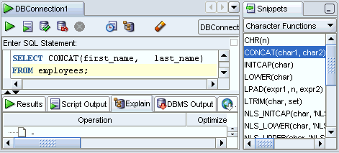
Using Snippets: Example
Inserting a
snippet
Editing the
snippet
Notes:
Using Snippets: Example
To insert a snippet into your code in a SQL Worksheet or in a PL/SQL function or procedure, drag the snippet from the Snippets window and drop it into the desired place in your code. Then you can edit the syntax so that the SQL function is valid in the current context. To see a brief description of a SQL function in a tool tip, hold the pointer over the function name.
The example in the slide shows that CONCAT(char1, char2) is dragged from the Character Functions group in the Snippets window. Then the CONCAT function syntax is edited and rest of the statement is added as follows:
SELECT CONCAT(first_name, last_name)
FROM employees;

Slide 19
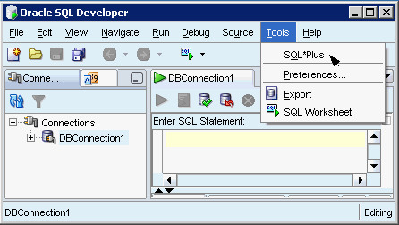
Using SQL*Plus
  The SQL Worksheet does not support all SQL*Plus statements
  You can invoke the SQL*Plus command-line interface from SQL Developer
Notes:
Oracle Database 10g: PL/SQL Fundamentals E-<number>
Using SQL*Plus
The SQL Worksheet supports some SQL*Plus statements. SQL*Plus statements must be interpreted by the SQL Worksheet before being passed to the database; any SQL*Plus statements that are not supported by the SQL Worksheet are ignored and not passed to the database.
To display the SQL*Plus command window, select SQL*Plus from the Tools menu.
To use this feature, the system on which you are using SQL Developer must have an Oracle Home directory or folder, with a SQL*Plus executable under that location. If the location of the SQL*Plus executable is not already stored in your SQL Developer preferences, you are asked to specify its location.

Slide 20
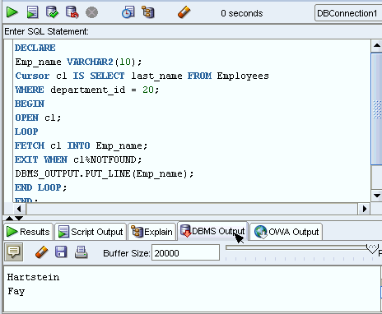
Creating an Anonymous Block
Create an anonymous block and display the output of DBMS_OUTPUT package statements.
Notes:
Creating an Anonymous Block
You can create an anonymous block and display the output of DBMS_OUTPUT package statements. To create an anonymous block and view the results, perform the following steps:
1. Enter the PL/SQL code in the Enter SQL Statement box.
2. Click the DBMS Output pane. Then click the Enable DBMS Output icon to set the server output ON.
3. Click the Execute Statement icon above the Enter SQL Statement box. Then click the DBMS Output pane to see the results.

Slide 21
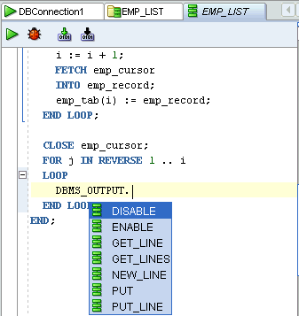
Editing the PL/SQL Code
Use the full-featured editor for PL/SQL program units:
Notes:
Editing the PL/SQL Code
You may want to make changes to your PL/SQL code. SQL Developer includes a full-featured editor for PL/SQL program units. It includes customizable PL/SQL syntax highlighting in addition to common editor functions such as:
Bookmarks
Code Completion
Code Folding
Search and Replace
To edit the PL/SQL code, click the object name in the Connections navigator, and then click the Edit icon. Optionally, double-click the object name to invoke the object definition page with its tabs and the Edit page. You can update only if you are in the Edit tab.
The Code Insight feature is shown on the slide. For example, if you type DBMS_OUTPUT. and then press [Ctrl] + [Space], you can select from a list of members of that package. Note that by default, Code Insight is invoked automatically if you pause after typing a period (.) for more than one second.
When using the Code Editor to edit PL/SQL code, you can “Compile” or “Compile for Debug.”

Slide 22
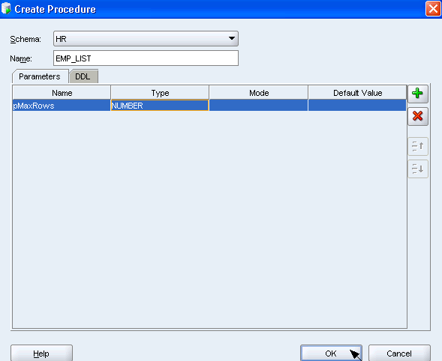
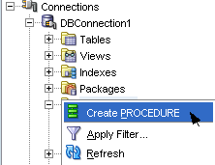
Creating a PL/SQL Procedure
1
2
Notes:
Creating a PL/SQL Procedure
Using SQL Developer, you can create PL/SQL functions, procedures, and packages. To create a Pl/SQL procedure, perform the following steps:
1. Right-click the Procedures node in the Connections Navigator to invoke the context menu, and select Create Procedure.
2. In the Create Procedure dialog box, specify the procedure information and click OK.
Note: Ensure that you press Enter before you click OK.
In the example in the slide, the EMP_LIST procedure is created. The default values for parameter name and parameter type are replaced with pMaxRows and NUMBER respectively.

Slide 23
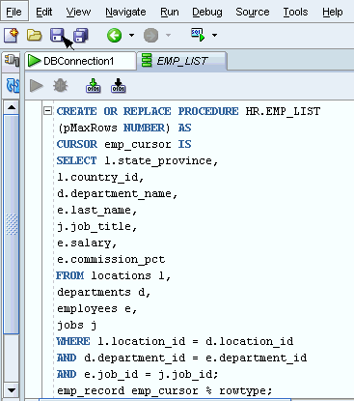
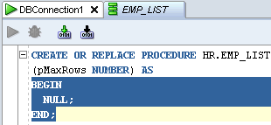
Compiling a PL/SQL Procedure
Notes:
Compiling a PL/SQL Procedure
Once you specify the parameter information in the Create Procedure dialog box and click OK, you see the procedure tab added in the right window. You can then replace the Anonymous block with your PL/SQL code.
To compile the PL/SQL subprogram, click the Save button in the toolbar. If you expand Procedures in the Connections Navigator, you can see that the procedure node is added.
When an invalid PL/SQL subprogram is detected by SQL Developer, the status is indicated with a red X over the icon for the subprogram in the Connections Navigator. Compilation errors are shown in the log window. You can navigate to the line reported in the error by simply double-clicking on the error. SQL Developer also displays errors and hints in the right hand gutter. If you hover each of the red bars in the gutter, the error message displays. For example, if the error messages indicate that there is a formatting error, modify the code accordingly and click the Compile icon.

Slide 24
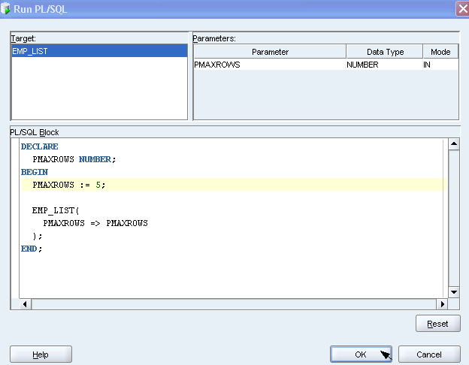
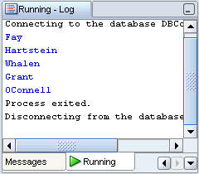
Running a PL/SQL Procedure
Notes:
Running a PL/SQL Procedure
Once you have created and compiled a PL/SQL procedure, you can run it using SQL Developer. To run a PL/SQL procedure, right-click the procedure name in the left navigator and select Run. Optionally, you can use the Run button in the right window. This invokes the Run PL/SQL dialog box. The Run PL/SQL dialog box allows you to select the target procedure or function to run and displays a list of parameters for the selected target.
You can use the PL/SQL block area to populate parameters to be passed to the program unit and to handle complex return types. Once you make the necessary changes in the Run PL/SQL dialog box, click OK. You see the expected results in the Running-Log window.
In the example in the slide, PMAXROWS := NULL; is changed to PMAXROWS := 5;
The results of the five rows returned are displayed in the Running-Log window.

Slide 25
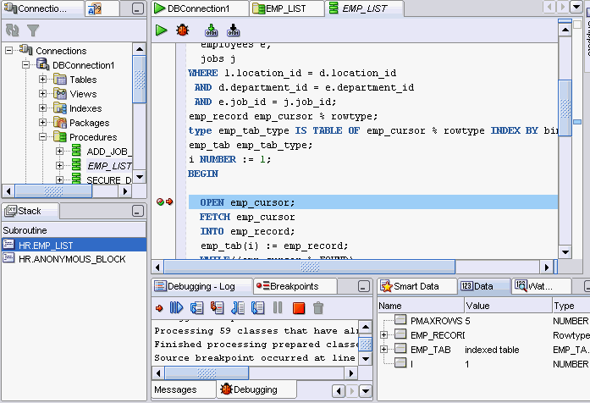
Debugging PL/SQL
Notes:
Debugging PL/SQL
You may want to debug a PL/SQL function, procedure or package. SQL Developer provides full support for PL/SQL debugging. To debug a function or procedure, perform the following steps:
1. Click the object name in the Connections navigator
2. Right-click the object and select Compile for debug.
3. Click the Edit icon. Then click the Debug icon above its source listing.
If the toggle numbers before each line of code is not yet displayed, right-click in the Code Editor margin and select Toggle Line Numbers.
The PL/SQL debugger supplies many commands to control program execution including Step Into, Step Over, Step Out, Run to Cursor, and so on. While the debugger is paused, you can examine and modify the values of variables from the Smart Data, Watches or Inspector windows.
The Breakpoints window lists the defined breakpoints. You can use this window to add new breakpoints, or customize the behavior of existing breakpoints.
Note: For PL/SQL debugging, you need the debug any procedure and debug connect session privileges.

Slide 26
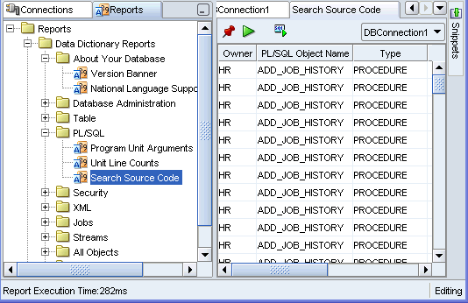
Database Reporting
SQL Developer provides a number of predefined reports about the database and its objects:
Notes:
Database Reporting
SQL Developer provides many reports about the database and its objects. These reports can be grouped into the following categories:
About Your Database reports
Database Administration reports
Table reports
PL/SQL reports
Security reports
XML reports
Jobs reports
Streams reports
All Objects reports
Data Dictionary reports
User Defined reports
To display reports, click the Reports tab on the left side of the window. Individual reports are displayed in tabbed panes on the right side of the window; and for each report, you can select (in a drop-down control) the database connection for which to display the report. For reports about objects, the objects shown are only those visible to the database user associated with the selected database connection, and the rows are usually ordered by Owner.

Slide 27
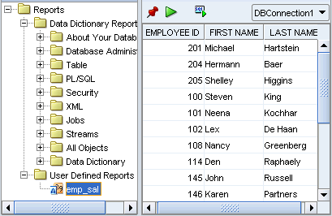
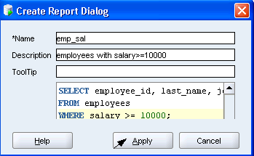
Creating a User Defined Report
Create and save user-defined reports for repeated use:
Notes:
Creating a User Defined Report
User Defined reports are any reports that are created by SQL Developer users. To create a user-defined report, perform the following steps:
1. Right-click the User Defined Reports node under Reports, and select Add Report.
2. In the Create Report Dialog box, specify the report name and the SQL query to retrieve information for the report. Then click Apply.
In the example in the slide, the report name is specified as emp_sal. An optional description is provided indicating that the report contains details of employees with salary >= 10000. The complete SQL statement for retrieving the information to be displayed in the user-defined report is specified in the SQL box. You can also include an optional tool tip to be displayed when the mouse pointer stays briefly over the report name in the Reports navigator display.
You can organize user-defined reports in folders, and you can create a hierarchy of folders and subfolders. To create a folder for user-defined reports, right-click the User Defined node or any folder name under that node and select Add Folder.
Information about user-defined reports, including any folders for these reports, is stored in a file named UserReports.xml under the directory for user-specific information.

Slide 28
Summary
In this appendix, you should have learned how to use SQL Developer to do the following:
  Browse, create, and edit database objects
  Execute SQL statements and scripts in the SQL Worksheet
  Edit and debug PL/SQL statements
  Create and save custom reports
Notes:
Oracle Database 10g: PL/SQL Fundamentals E-<number>
Summary
SQL Developer is a free graphical tool to simplify database development tasks. Using SQL Developer, you can browse, create, and edit database objects. You can use the SQL Worksheet to run SQL statements and scripts. Using SQL Developer, you can edit and debug PL/SQL.
SQL Developer enables you to create and save your own special set of reports for repeated use.

